Slide 1
RR Diner Project
Mehmet Ozer

Slide 2
Statement of the Problem
RR Diner Coffee sells two types of coffee; specialty coffee beans, in bulk or coffee equipment and merchandise (grinders, brewing equipment, mugs, books, t-shirts). They have three stores, two in Europe and one in the USA. The flagship store is in the USA, and everything is quality assessed there, before being shipped out. Customers further away from the USA flagship store have higher shipping charges. Even though they buy and process coffee in US they sell have customers internationally.
Now, RR Diner Coffee has a decision about whether to strike a deal with a legendary coffee farm (known as the Hidden Farm) in rural China. It's a risky decision, as the deal will be expensive, and the coffee might not be bought by customers. The stakes are high: times are tough, stocks are low, farmers are reverting to old deals with the larger enterprises and the publicity of selling Hidden Farm coffee could save the RR Diner Coffee business.

Slide 3
Purpose of the Study
The goal of this project is to identify if the RR Diner Coffee should make a deal with Hidden Farm which is located in rural China. Such deal might help the survival of the company which is already struggling or might go even worse if the deal with Hidden Farm does no help the company to survive.
To find a meaningful answer for this study data were gathered from the customers by a survey. Collected data included demographic information along with whether they have bought at least one RR Diner Coffee product online, their distance from the flagship store in the USA , how much they spent on RR Diner Coffee products on the week of the survey, how much they spent on RR Diner Coffee products in the month preceding the survey, the number of RR Diner coffee bean shipments each customer has ordered over the preceding year.

Slide 4
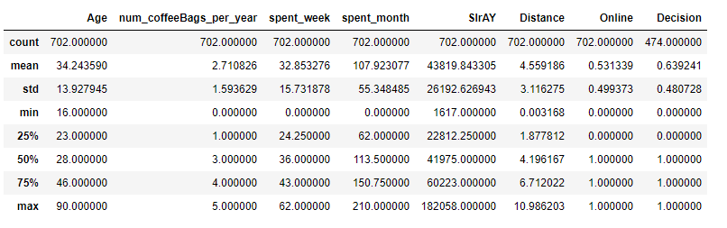
Exploratory Data Analysis
The table below shows a description of the data collected on our customers. The average age of our customers is 34, the average amount coffee bags we sell per year is 2.7, average salary of the customers is $43,819, average distance is 4.56.

Slide 5
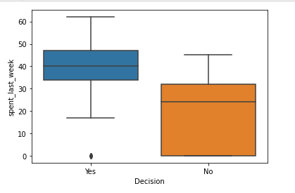
Customers
The customers who made an order recently usually mentioned that they will be interested in Hidden Farm coffee. But the customers who did not make a purchase during the week of survey mostly were not interested in the Hidden Farm product.

Slide 6
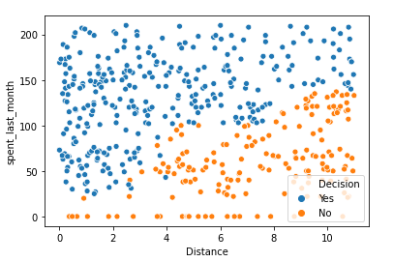
Customers
The customers who spent more during the month before the survey was conducted and who are located closer to the flagship store were more interested in the Hidden Farm product compared to other customers.

Slide 7
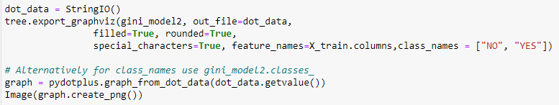
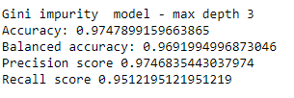
Decision Tree Analysis
Decision Tree analysis was used to classify if customers will buy the product or not. Multiple models were used and the best performing model was chosen. The best model was Gini impurity model with max depth of 3.

Slide 8
Conclusion
The company has decided if more than 65% of the interviewed customers are likely to buy the Hidden Farm coffee, they will strike the deal with the Hidden Farm farmers and sell the coffee. Otherwise, they won't strike the deal and the Hidden Farm coffee will remain in legends only. There was some doubt about whether 65% is a reasonable threshold, but it'll do for the moment
Based on the best model we are at 69% and I will recommend the company to strike the deal based on my analysis.

